Slide 1

Object-Oriented Programming Concepts
Notes:
(c) 2006 National Academy for Software Development - http://academy.devbg.org

Slide 2

Contents
What is OOP?
Classes and Objects
Principles of OOP
  Inheritance
  Abstraction
  Encapsulation
  Polymorphism
Notes:
(c) 2006 National Academy for Software Development - http://academy.devbg.org

Slide 3

What is OOP?
Notes:
(c) 2006 National Academy for Software Development - http://academy.devbg.org

Slide 4
What is OOP?
Object-oriented programming (OOP) is an engineering approach for building software systems
  Based on the concepts of classes and objects that are used for modeling the real world entities
Object-oriented programs
  Consist of a group of cooperating objects
  Objects exchange messages, for the purpose of achieving a common objective
  Implemented in object-oriented languages
Notes:
(c) 2006 National Academy for Software Development - http://academy.devbg.org

Slide 5
OOP in a Nutshell
A program models a world of interacting objects
Objects create other objects and “send messages” to each other (in Java, call each other’s methods)
Each object belongs to a class
  A class defines properties of its objects
  The data type of an object is its class
Programmers write classes (and reuse existing classes)
Notes:
(c) 2006 National Academy for Software Development - http://academy.devbg.org

Slide 6
What are OOP’s Claims To Fame?
Better suited for team development
Facilitates utilizing and creating reusable software components
Easier GUI programming
Easier software maintenance
All modern languages are object-oriented: Java, C#, PHP, Perl, C++, ...
Notes:
(c) 2006 National Academy for Software Development - http://academy.devbg.org
<number>##
(c) 2006 National Academy for Software Development - http://academy.devbg.org*
*
07/16/96
The industry has embraced OOP, but no formal studies of these claimed benefits have been carried out.

Slide 7
Classes and Objects
Notes:
(c) 2006 National Academy for Software Development - http://academy.devbg.org

Slide 8
What Are Objects?
Software objects model real-world objects or abstract concepts
  E.g. dog, bicycle, queue
Real-world objects have states and behaviors
  Dogs' states: name, color, breed, hungry
  Dogs' behaviors: barking, fetching, sleeping
Notes:
(c) 2006 National Academy for Software Development - http://academy.devbg.org

Slide 9
What Are Objects?
How do software objects implement real-world objects?
  Use variables/data to implement states
  Use methods/functions to implement behaviors
An object is a software bundle of variables and related methods
Notes:
(c) 2006 National Academy for Software Development - http://academy.devbg.org

Slide 10
Objects Represent
 checks
 people
 shopping list
…
 numbers
 characters
 queues
 arrays
Things in the real world
Things in the computer world
Notes:
(c) 2006 National Academy for Software Development - http://academy.devbg.org

Slide 11
Classes
Classes provide the structure for objects
  Define their prototype
Classes define:
  Set of attributes
    Also called state
    Represented by variables and properties
  Behavior
    Represented by methods
A class defines the methods and types of data associated with an object
Notes:
(c) 2006 National Academy for Software Development - http://academy.devbg.org

Slide 12
Objects
Creating an object from a class is called instantiation
An object is a concrete instance of a particular class
Objects have state
  Set of values associated to their attributes
Example:
  Class: Account
  Objects: Ivan's account, Peter's account
Notes:
(c) 2006 National Academy for Software Development - http://academy.devbg.org

Slide 13
Classes – Example
Class
Attributes
Account
+Owner: Person
+Ammount: double
+suspend()
+deposit(sum:double)
+withdraw(sum:double)
Operations
Notes:
(c) 2006 National Academy for Software Development - http://academy.devbg.org

Slide 14
Classes and Objects – Example
Object
Class
ivanAccount
+Owner="Ivan Kolev"
+Ammount=5000.0
Account
+Owner: Person
+Ammount: double
Object
peterAccount
+suspend()
+deposit(sum:double)
+withdraw(sum:double)
+Owner="Peter Kirov"
+Ammount=1825.33
kirilAccount
Object
+Owner="Kiril Kirov"
+Ammount=25.0
Notes:
(c) 2006 National Academy for Software Development - http://academy.devbg.org

Slide 15
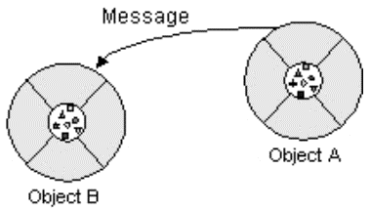
Messages
What is a message in OOP?
  A request for an object to perform one of its operations (methods)
All communication between objects is done via messages
Notes:
(c) 2006 National Academy for Software Development - http://academy.devbg.org

Slide 16
Interfaces
Messages define the interface to the object
  Everything an object can do is represented by its message interface
The interfaces provide abstractions
  You shouldn't have to know anything about what is in the implementation in order to use it (black box)
An interface is a set of operations (methods) that given object can perform
Notes:
(c) 2006 National Academy for Software Development - http://academy.devbg.org

Slide 17
The Principles of OOP
Notes:
(c) 2006 National Academy for Software Development - http://academy.devbg.org

Slide 18
The Principles of OOP
Inheritance
Abstraction
Encapsulation
Polymorphism
Notes:
(c) 2006 National Academy for Software Development - http://academy.devbg.org

Slide 19
Inheritance
A class can extend another class, inheriting all its data members and methods
  The child class can redefine some of the parent class's members and methods and/or add its own
A class can implement an interface, implementing all the specified methods
Inheritance implements the “is a” relationship between objects
Notes:
(c) 2006 National Academy for Software Development - http://academy.devbg.org

Slide 20
Inheritance
Terminology
subclass
or
derived class
superclass
or
base class
extends
subinterface
extends
superinterface
class
implements
interface
Notes:
(c) 2006 National Academy for Software Development - http://academy.devbg.org

Slide 21


Inheritance
Superclass
Person
+Name: String
+Address: String
Subclass
Subclass
Employee
Student
+Company: String
+Salary: double
+School: String
Notes:
(c) 2006 National Academy for Software Development - http://academy.devbg.org

Slide 22
Inheritance in Java
In Java, a subclass can extend only one superclass
In Java, a subinterface can extend one superinterface
In Java, a class can implement several interfaces
  This is Java’s form of multiple inheritance
Notes:
(c) 2006 National Academy for Software Development - http://academy.devbg.org

Slide 23
Interfaces and Abstract Classes in Java
An abstract class can have code for some of its methods
  Other methods are declared abstract and left with no code
An interface only lists methods but does not have any code
A concrete class may extend an abstract class and/or implement one or several interfaces, supplying the code for all the methods
Notes:
(c) 2006 National Academy for Software Development - http://academy.devbg.org

Slide 24
Inheritance Benefits
Inheritance plays a dual role:
  A subclass reuses the code from the superclass
  A subclass inherits the data type of the superclass (or interface) as its own secondary type
Notes:
(c) 2006 National Academy for Software Development - http://academy.devbg.org

Slide 25


Class Hierarchies
Inheritance leads to a hierarchy of classes and/or interfaces in an application:
Game
Solitaire
GameFor2
BoardGame
Chess
Backgammon
Notes:
(c) 2006 National Academy for Software Development - http://academy.devbg.org

Slide 26
Inheritance
An object of a class at the bottom of a hierarchy inherits all the methods of all the classes above
It also inherits the data types of all the classes and interfaces above
Inheritance is also used to extend hierarchies of library classes
  Allows reusing the library code and inheriting library data types
Notes:
(c) 2006 National Academy for Software Development - http://academy.devbg.org

Slide 27

Abstraction
Abstraction means ignoring irrelevant features, properties, or functions and emphasizing the relevant ones...
... relevant to the given project (with an eye to future reuse in similar projects)
Abstraction = managing complexity
“Relevant” to what?
Notes:
(c) 2006 National Academy for Software Development - http://academy.devbg.org

Slide 28
Abstraction
Abstraction is something we do every day
  Looking at an object, we see those things about it that have meaning to us
  We abstract the properties of the object, and keep only what we need
Allows us to represent a complex reality in terms of a simplified model
Abstraction highlights the properties of an entity that we are most interested in and hides the others
Notes:
(c) 2006 National Academy for Software Development - http://academy.devbg.org

Slide 29
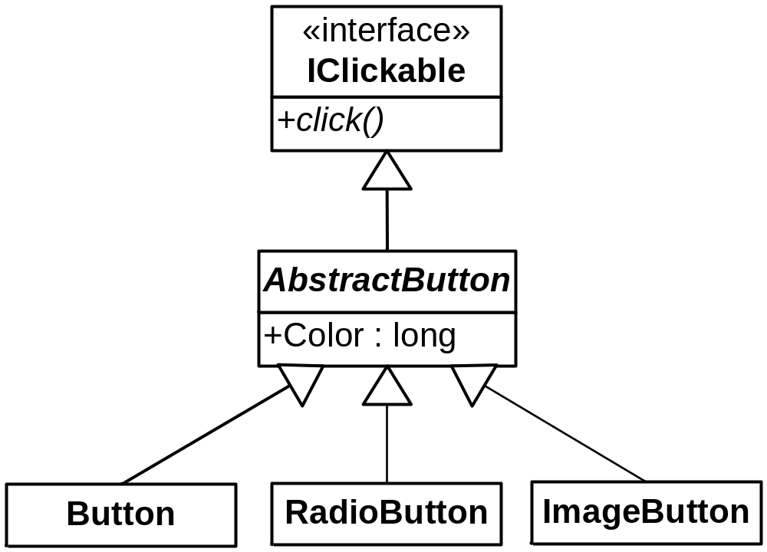
Abstraction in Java
In Java abstraction is achieved by use of
  Abstract classes
  Interfaces
Notes:
(c) 2006 National Academy for Software Development - http://academy.devbg.org

Slide 30
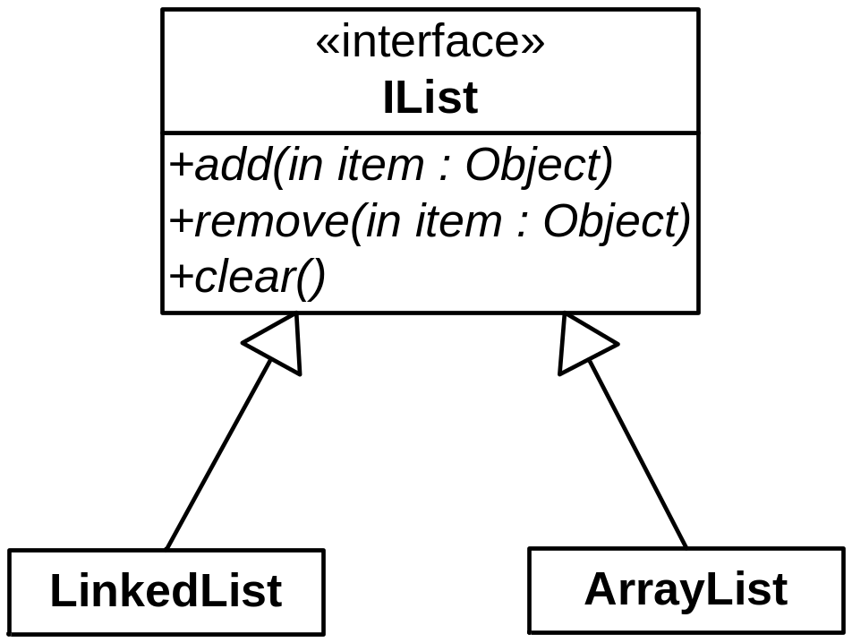
Abstract Data Types
Abstract Data Types (ADT) are data types defined by a set of operations
Examples:
Notes:
(c) 2006 National Academy for Software Development - http://academy.devbg.org

Slide 31
Abstraction in AWT/Swing
java.lang.Object
|
+--java.awt.Component
|
+--java.awt.Container
|
+--javax.swing.JComponent
|
+--javax.swing.AbstractButton
Notes:
(c) 2006 National Academy for Software Development - http://academy.devbg.org

Slide 32
Encapsulation
Encapsulation means that all data members (fields) of a class are declared private
  Some methods may be private, too
The class interacts with other classes (called the clients of this class) only through the class’s constructors and public methods
Constructors and public methods of a class serve as the interface to class’s clients
Notes:
(c) 2006 National Academy for Software Development - http://academy.devbg.org

Slide 33
Encapsulation
Ensures that structural changes remain local:
  Usually, the internal structure of a class changes more often than the class’s constructors and methods
  Encapsulation ensures that when fields change, no changes are needed in other classes (a principle known as “locality”)
Hiding implementation details reduces complexity → easier maintenance
Notes:
(c) 2006 National Academy for Software Development - http://academy.devbg.org

Slide 34
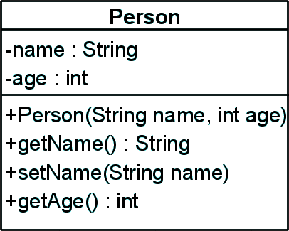
Encapsulation – Example
Data Fields are private
Constructors and accessor methods are defined
Notes:
(c) 2006 National Academy for Software Development - http://academy.devbg.org

Slide 35
Polymorphism
Ability to take more than one form
  A class can be used through its parent class's interface
  A subclass may override the implementation of an operation it inherits from a superclass (late binding)
Polymorphism allows abstract operations to be defined and used
  Abstract operations are defined in the base class's interface and implemented in the subclasses
Notes:
(c) 2006 National Academy for Software Development - http://academy.devbg.org

Slide 36
Polymorphism
Why use an object as a more generic type?
  To perform abstract operations
  To mix different related types in the same collection
  To pass it to a method that expects a parameter of a more generic type
  To declare a more generic field (especially in an abstract class) which will be initialized and “specialized” later
Notes:
(c) 2006 National Academy for Software Development - http://academy.devbg.org

Slide 37
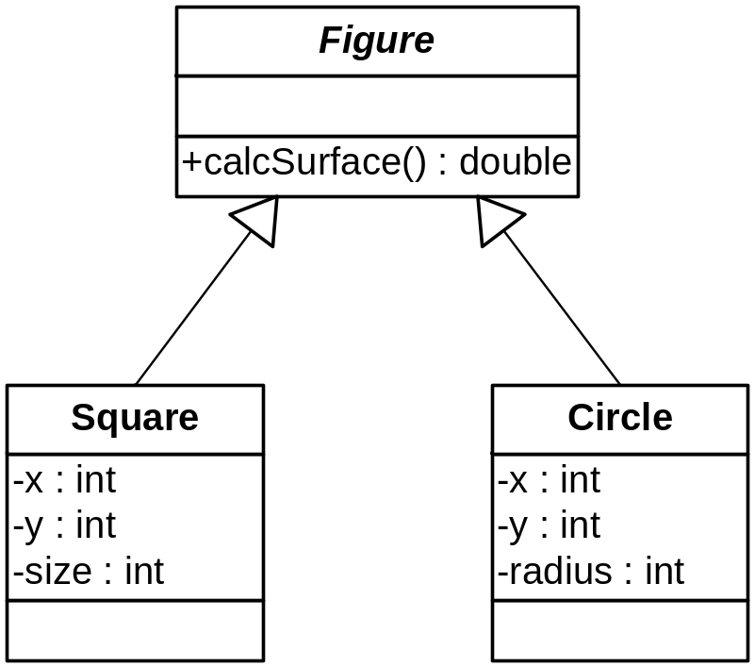
Polymorphism – Example
Abstract class
Abstract action
Concrete class
Overriden action
Overriden action
Square::calcSurface() {
return size * size;
}
Circle::calcSurface() {
return PI * radius * raduis;
}
Notes:
(c) 2006 National Academy for Software Development - http://academy.devbg.org

Slide 38
Polymorphism
Polymorphism ensures that the appropriate method is called for an object of a specific type when the object is disguised as a more generic type:
Figure f1 = new Square(...);
Figure f2 = new Circle(...);
// This will call Square::calcSurface()
int surface = f1.calcSurface();
// This will call Square::calcSurface()
int surface = f2.calcSurface();
Notes:
(c) 2006 National Academy for Software Development - http://academy.devbg.org

Slide 39
Polymorphism in Java
Good news: polymorphism is already supported in Java
  All you have to do is use it properly
Polymorphism is implemented using a technique called late method binding:
  Exact method to call is determined at run time before performing the call
Notes:
(c) 2006 National Academy for Software Development - http://academy.devbg.org

Slide 40
OOP Concepts
Questions?

Slide 41
Problems
Describe the term object in OOP.
Describe the term class in OOP.
Describe the term interface in OOP.
Describe the term inheritance in OOP.
Describe the term abstraction in OOP.
Describe the term encapsulation in OOP.
Describe the term polymorphism in OOP.
Notes:
(c) 2006 National Academy for Software Development - http://academy.devbg.org

